Slide 1
Class 20
FTAs and Other Trade Deals by
Alan V. Deardorff
University of Michigan
2022
PubPol/Econ 541

Slide 2
Quiz
 | Q6 | Q7 | Q8 | Q9
Mean | 7.20 | 7.20 | 7.50 | 6.30
Median | 8 | 7.5 | 7 | 6.5
Max | 9.5 | 10 | 10 | 10
Min | 3 | 3.5 | 4.5 | 1
S.D. | 1.86 | 1.65 | 1.76 | 2.39

Slide 3
Pause for News

Slide 4
Outline
FTAs in general
North America
  NAFTA
  USMCA
RCEP
CPTPP
EU and Other
UK and Other
Other

Slide 5
FTAs in General
Types
  Free Trade Agreement (FTA)
    Zero tariffs on (most) imports from partners
    Unequal tariffs on imports from outsiders
    Rules of origin (ROOs)
  Customs Union
    Zero tariffs on imports from partners
    Common external tariffs on outsiders
    No need for ROOs
  Common Market
    Customs Union plus other free movement

Slide 6
FTAs in General
Proliferation: Now more than 300, involving a significant fraction of possible country pairs
Most are FTAs
WTO reports all as “Regional Trade Agreements” (RTAs), though many include distant countries

Slide 7
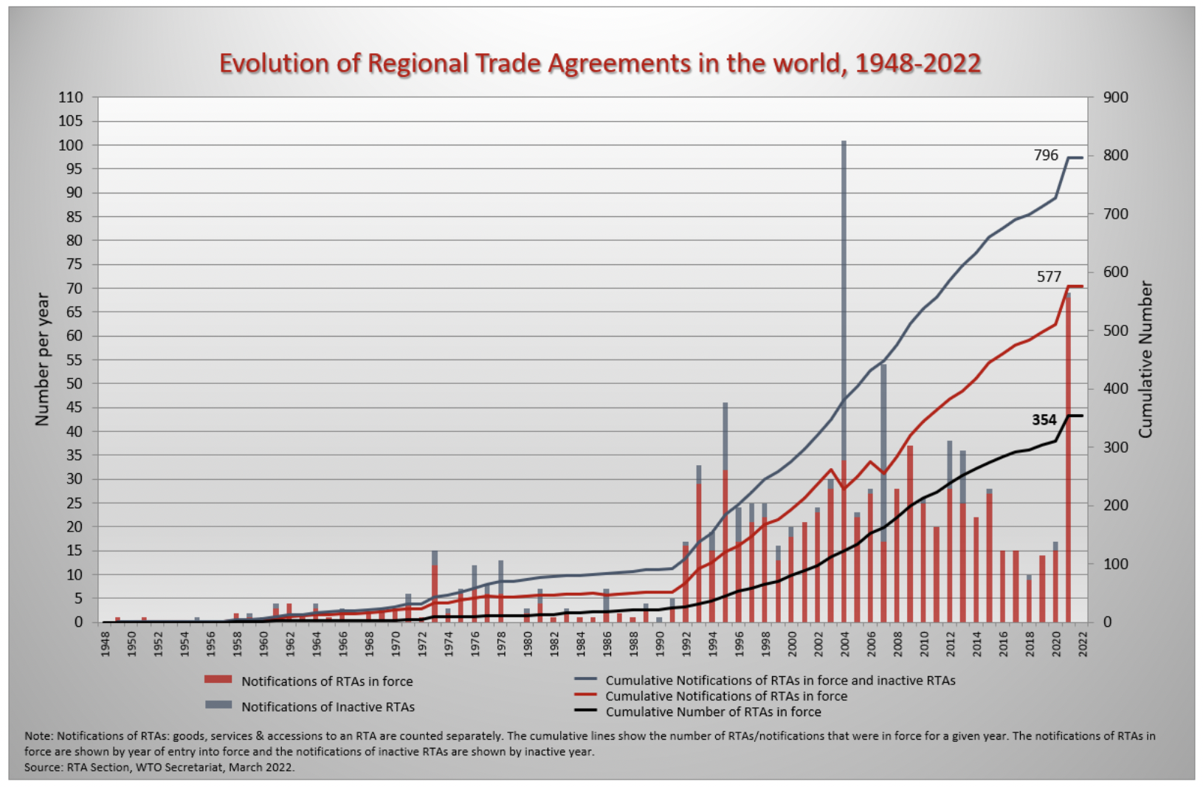
Surge in 2021 was mostly UK doing FTAs with former EU partners.
Source: WTO
Notes:
WTO
https://www.wto.org/english/tratop_e/region_e/region_e.htm#facts

Slide 16
Pause for Discussion

Slide 17
  Questions
  (Not asked before)
Why are ROOs necessary in FTA but not in Customs Union?
Why is the matrix of FTAs plus CUs so much fuller than the matrix of just FTAs? Are there really a lot of CUs?

Slide 18
NAFTA
What it was
  An FTA between US, Canada, and Mexico
  Went into effect Jan 1, 1994
Effects
  Trade
  Wages
  Employment
  Supply chains
  Consumers

Slide 19
NAFTA Effects
Trade
  Grew massively across N. America
  US bilateral trade with Mexico became deficits: US imports > US exports
  Supply chains, especially in autos, extended across North America

Slide 20
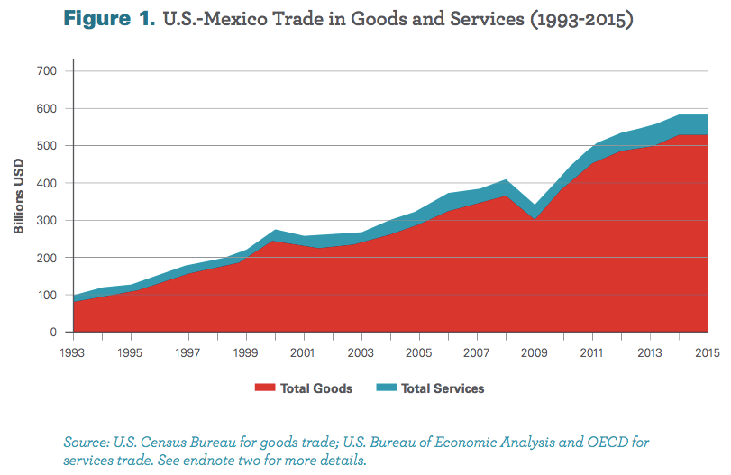
From: Wilson, Christopher, Growing Together: Economic Ties between the United States and Mexico, Wilson Center, March 2017.

Slide 21
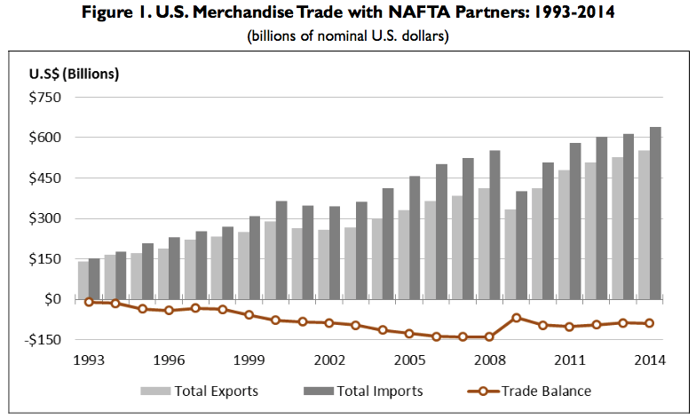
Source: Congressional Research Service (2015)

Slide 22
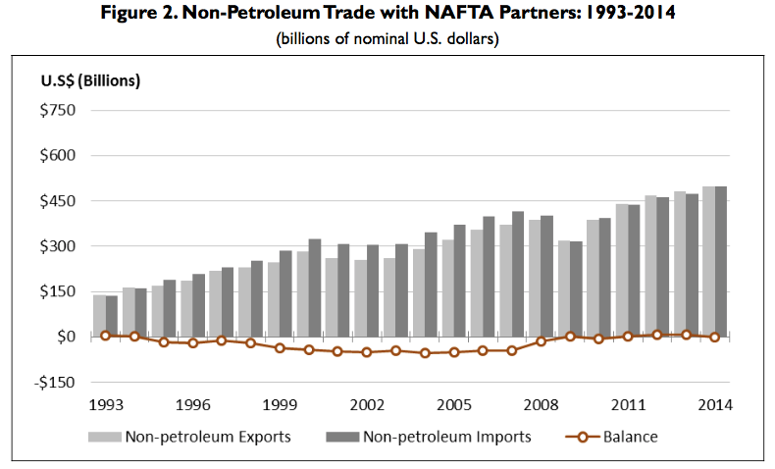
Note near balance
Source: Congressional Research Service (2015)

Slide 23
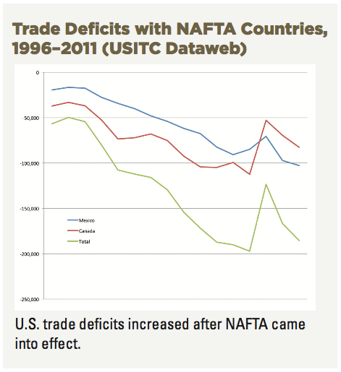
Source: AFL-CIO, “NAFTA at 20”

Slide 24
NAFTA Effects
Wages
  Fell in Mexico
  No effect on average in US

Slide 25
Real Wages Plummeted!
What Happened: Mexico
NAFTA
Peso Crisis

Slide 26
Real Wage: No Change
What Happened: U.S.
NAFTA
Peso Crisis

Slide 27
NAFTA Effects
Employment
  No effect on overall US employment or unemployment
  Pockets of disruption across US

Slide 28
Unemployment: No effect (or fell)
What Happened: U.S.
NAFTA
Peso Crisis

Slide 29
NAFTA Effects
Supply chains
  US manufacturing moved inputs to low-cost locations across N. America

Slide 30
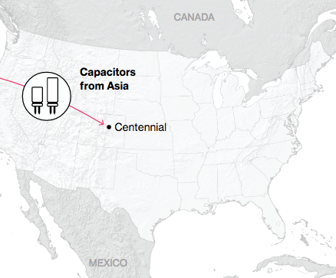
NAFTA and the Auto Supply Chain
Black, Diamond, and Merrill, “One Tiny Widget’s Dizzying Journey Shows Just How Critical Nafta Has Become,” Bloomberg, February 2, 2017.

Slide 31
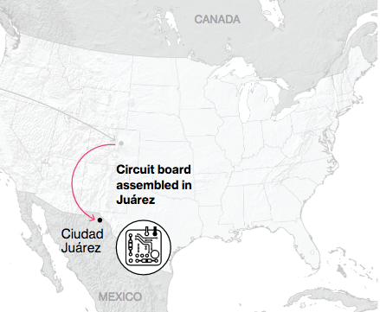
NAFTA and the Auto Supply Chain
Black, Diamond, and Merrill, “One Tiny Widget’s Dizzying Journey Shows Just How Critical Nafta Has Become,” Bloomberg, February 2, 2017.

Slide 32
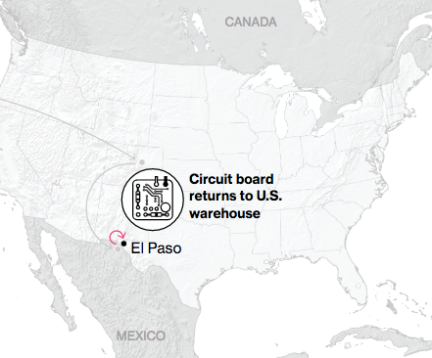
NAFTA and the Auto Supply Chain
Black, Diamond, and Merrill, “One Tiny Widget’s Dizzying Journey Shows Just How Critical Nafta Has Become,” Bloomberg, February 2, 2017.

Slide 33
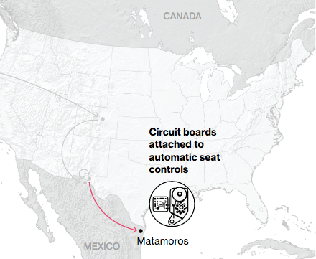
NAFTA and the Auto Supply Chain
Black, Diamond, and Merrill, “One Tiny Widget’s Dizzying Journey Shows Just How Critical Nafta Has Become,” Bloomberg, February 2, 2017.

Slide 34
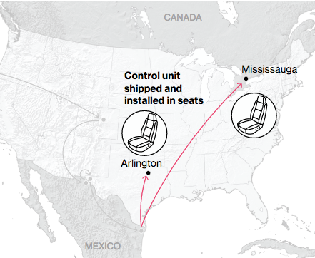
NAFTA and the Auto Supply Chain
Black, Diamond, and Merrill, “One Tiny Widget’s Dizzying Journey Shows Just How Critical Nafta Has Become,” Bloomberg, February 2, 2017.

Slide 35
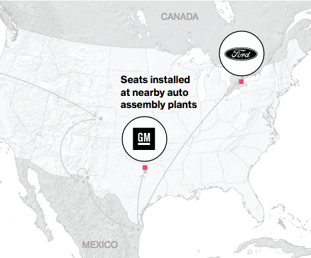
NAFTA and the Auto Supply Chain
Black, Diamond, and Merrill, “One Tiny Widget’s Dizzying Journey Shows Just How Critical Nafta Has Become,” Bloomberg, February 2, 2017.

Slide 36
NAFTA Effects
Consumers
  As always with freer trade, the ultimate beneficiaries are consumers
    Lower prices for
      Imported consumer goods
      Domestically produced goods and services that use cheaper imported inputs
    Greater variety of goods to choose from
  These gains are hard to measure
    One indicator may be the low rates of price inflation experienced under NAFTA

Slide 37
Pause for Discussion

Slide 38
  Questions
I’ve not assigned anything evaluating NAFTA, since it’s been replaced by USMCA. But what were, and are, your impressions of NAFTA?

Slide 39
USMCA
What it is
  “United States, Mexico, Canada Agreement”
  Result of Trump’s renegotiation of NAFTA
  Mostly the same as NAFTA
Why replace NAFTA?
  Trump opposed NAFTA as early as 1993
    “The Mexicans want it, and that doesn't sound good to me.”
    Trump sees trade as zero-sum game
  Opposition to NAFTA was popular

Slide 40
USMCA Timeline
Renegotiation
  May 18, 2017: Renegotiation began
  Aug 27, 2018: Agreement between US and Mexico
  Sep 30, 2018: Agreement with Canada to join
Approval and Implementation
  Dec 19, 2019: US House approved (contentious)
  Jan 17, 2020: Senate approved (expected)
  Jan 29, 2020: Trump signed into law
  Jul 1, 2020: Agreement went into effect

Slide 41
USMCA Features
Car incentives
  ROO raised from 62.5% to 75%
  70% of steel & aluminum must come from NA
  40-45% of value added from >$16/hr labor
Dairy: Some opening of US dairy to Canada
ISDS only between US & Mexico (was for all in NAFTA)
  ISDS = Investor-State Dispute Settlement
Commitments on labor & IP standards
“Sunset Clause”: Review after 6 years
Inform US if negotiate with NME (China)
Commitment not to manipulate currencies
NEW

Slide 42
Pause for Discussion

Slide 43
  Questions on Kirby
How big a change is USMCA compared to NAFTA?
What industry or product seems to have gotten the most attention in the changes made to USMCA?
How are the rules of origin for cars and car parts changed in USMCA compared to NAFTA?
What is the “rapid-response mechanism”?

Slide 44
  Questions on Nakayama, “Japanese carmakers …”
How are Japanese car companies responding to USMCA rules?
Can you tell from this what the tariff rate would be if cars made in Mexico don’t have 40% of value from high-wage workers?
What are companies doing to respond to the USMCA rules?
What will USMCA do to the prices of cars in the US?

Slide 45
  Questions on Zumbrun,
  “U.S. Prevails Over Canada…”
Who made this decision favoring the US?
If Canada does not respond as instructed, what will the US do?
What Canadian policies did the US object to?

Slide 46
  Questions on Agren,
  “US, Canada Launch Dispute …”
At what stage is this dispute?
If they don’t resolve the issue in this stage, what happens next? Tariffs?
What are the US and Canada complaining about Mexico doing?
Does this have anything to do with clean energy?

Slide 47
RCEP
RCEP
  “Regional Comprehensive Economic Partnership”
  Large FTA being negotiated since 2013 by
    ASEAN 10 countries plus 5: China, Japan, South Korea, Australia and New Zealand
    India also, until it dropped out in November 2019
  Signed Nov 15, 2020

Slide 48
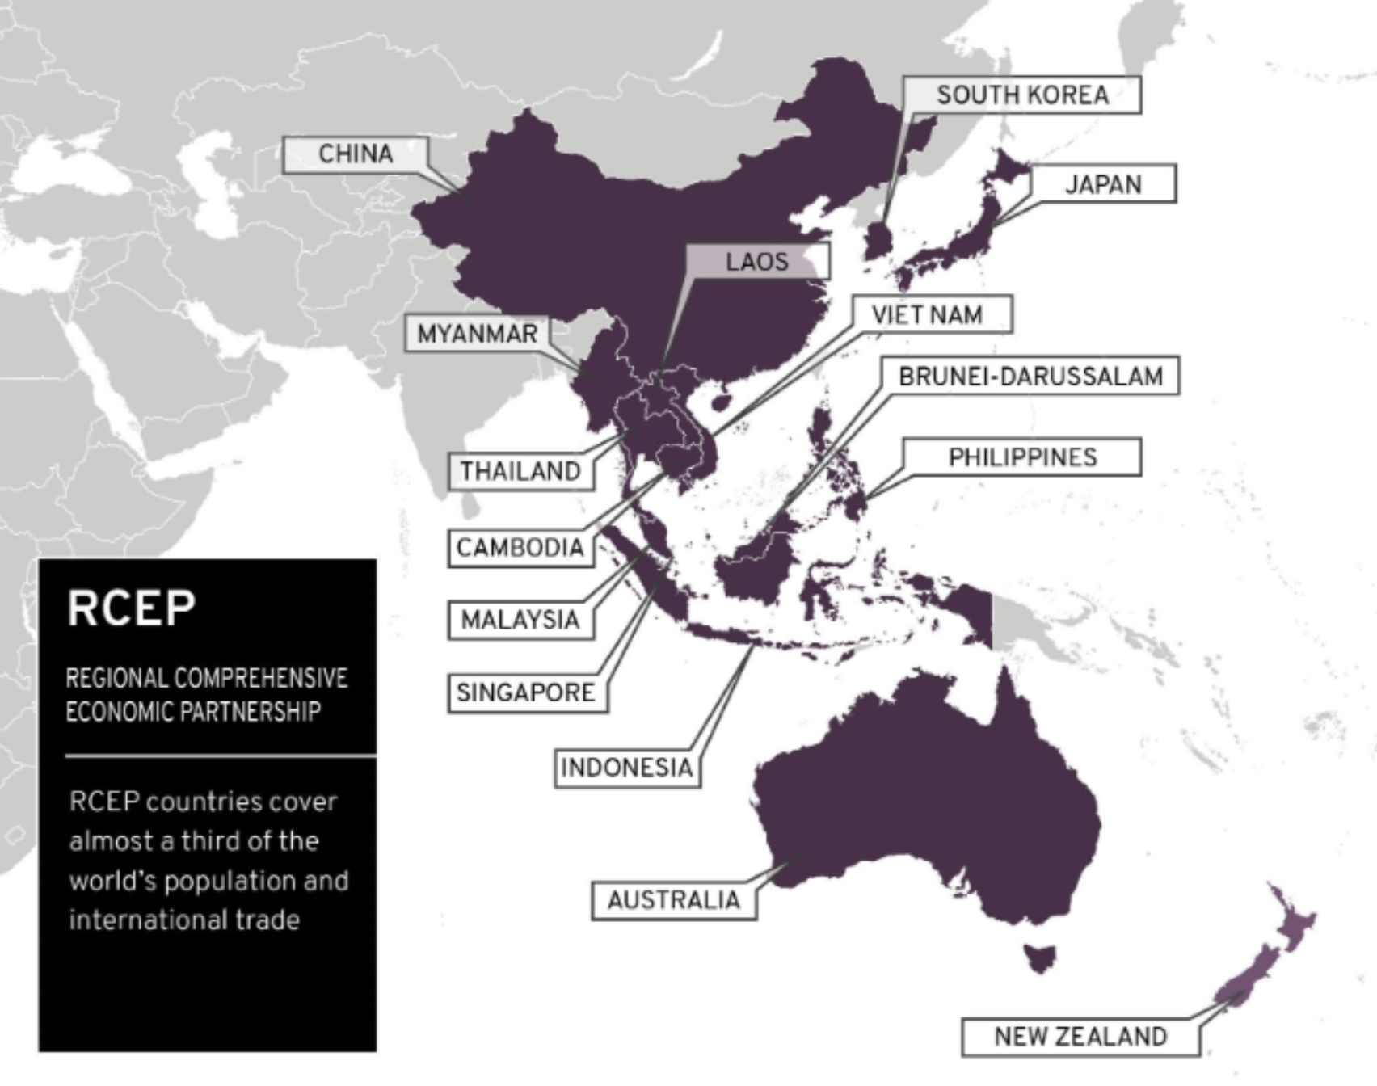
Notes:
https://www.mfat.govt.nz/en/trade/free-trade-agreements/free-trade-agreements-concluded-but-not-in-force/regional-comprehensive-economic-partnership-rcep/rcep-overview

Slide 49
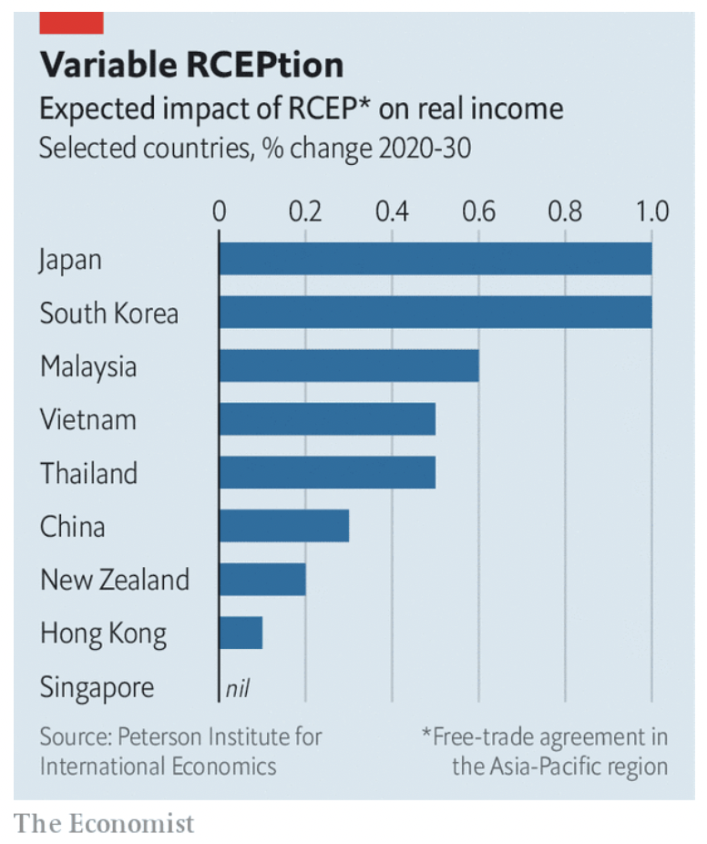
Notes:
Economist, "Big deal: Who gains from RCEP, Asia’s new trade pact?," The Economist, November 21, 2020.

Slide 50
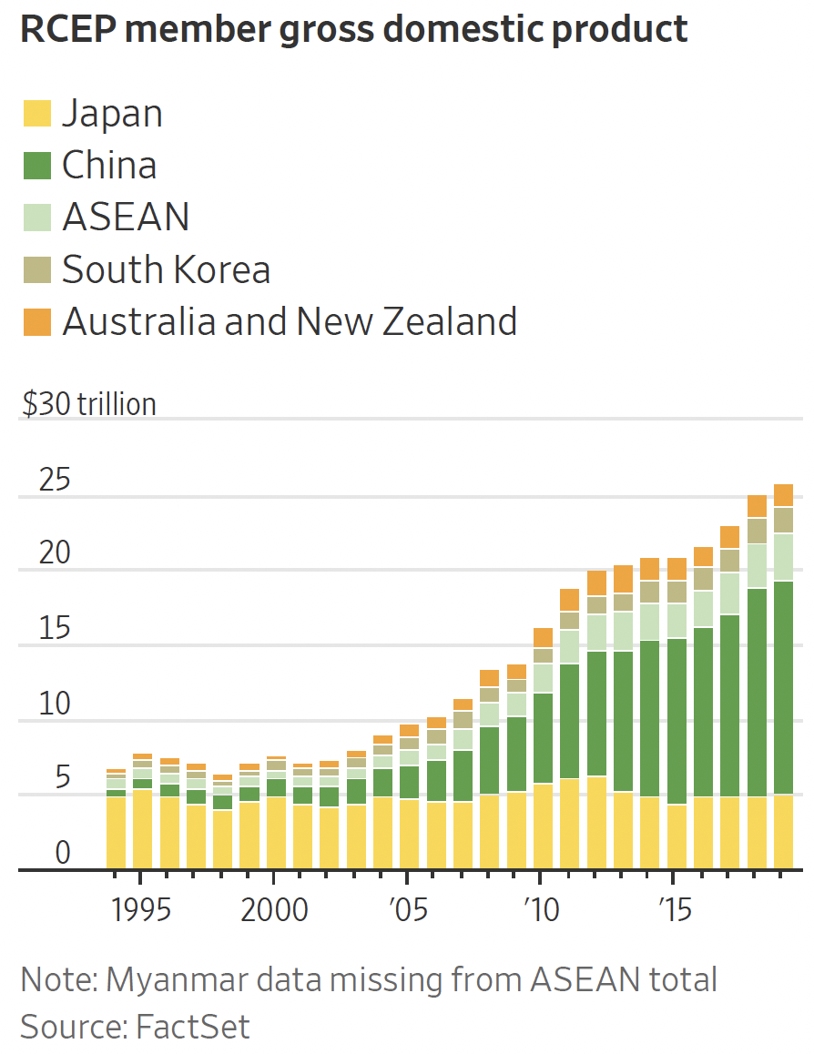
Notes:
Bird, Mike, "Asia’s Massive New Trade Deal Is No Big Victory for Beijing," Wall Street Journal, November 16, 2020.

Slide 51
Pause for Discussion

Slide 52
  Questions on Hayashi,
  “U.S. on Sidelines as …”
How many countries are in RCEP, and how does it compare in size to other trade agreements?
Who initiated the negotiations for RCEP?
Over what period are the tariff reductions of RCEP scheduled?
Does it eliminate all tariffs among the countries?
What rule of origin is applied in RCEP?

Slide 53
CPTPP
CPTPP
  “Comprehensive and Progressive Trans-Pacific Partnership”
  Successor to TPP after Trump pulled US out
  Includes 11 countries, including
    Japan
    Canada
    Mexico
    Australia
    Chile

Slide 54
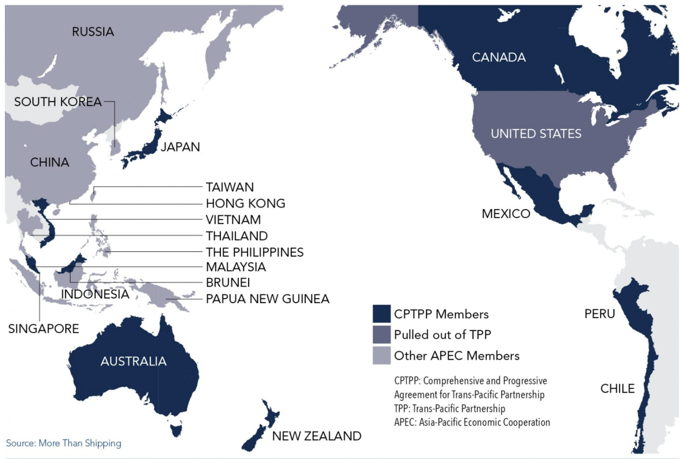
Notes:
https://advocacy.calchamber.com/policy/issues/trans-pacific-trade-relations/

Slide 55
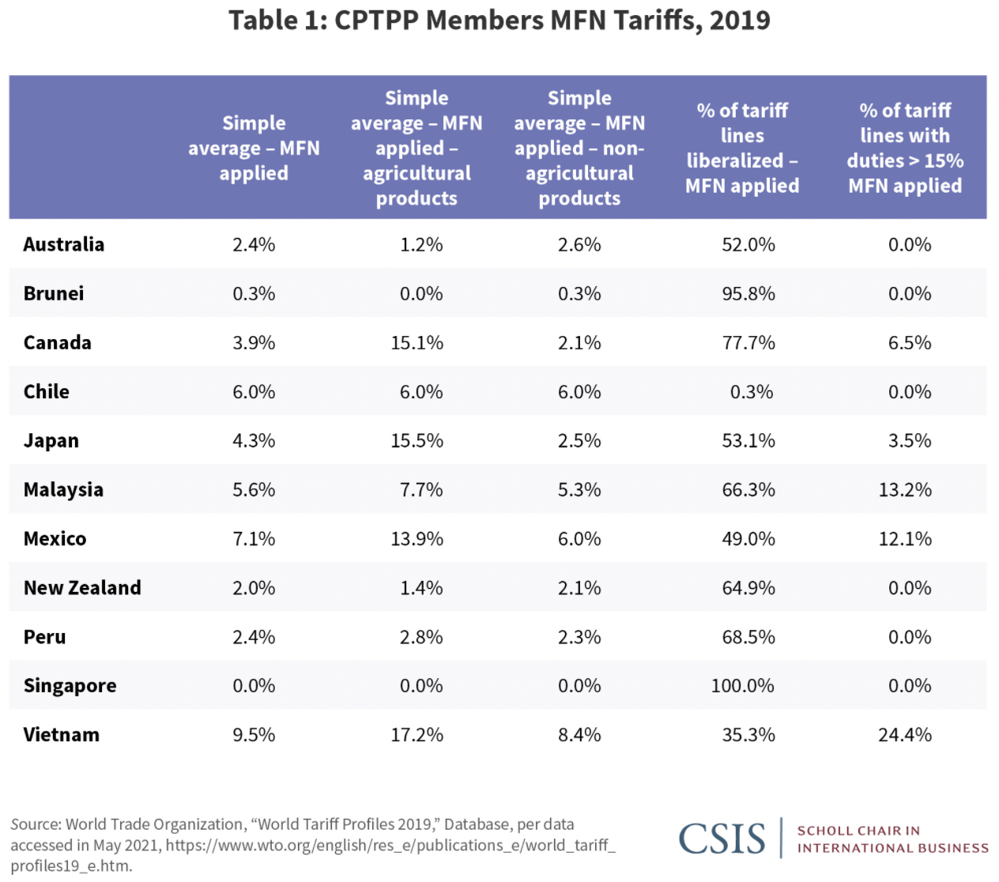
Notes:
“Two Years into CPTPP”, CSIS, August 9, 2021
https://www.csis.org/analysis/two-years-cptpp

Slide 56
Pause for Discussion

Slide 57
  Questions on Landers & Wright, “China’s Bid to Join TPP…”
What are reasons why China may find it difficult to meet the requirements of CPTPP membership?
Who else is mentioned here as having “expressed eagerness” to join CPTPP? Why would that be a problem?
Is President Biden likely to have the US rejoin this?

Slide 58
  Questions on Davies & Song, “South Korea Applies to Join…”
Why did South Korea not ask to join CPTPP earlier, and what changed?
Is anyone in South Korea fearful of joining CPTPP?
The idea of “trade diversion” is mentioned. Why?
Joining CPTPP will create free trade between South Korea and Japan. Why might this be a problem?

Slide 59
EU and Other
The EU has trade agreements with many other countries
  These have all reduced tariffs
  But the EU is concerned that many tariffs have been replaced by NTBs

Slide 60
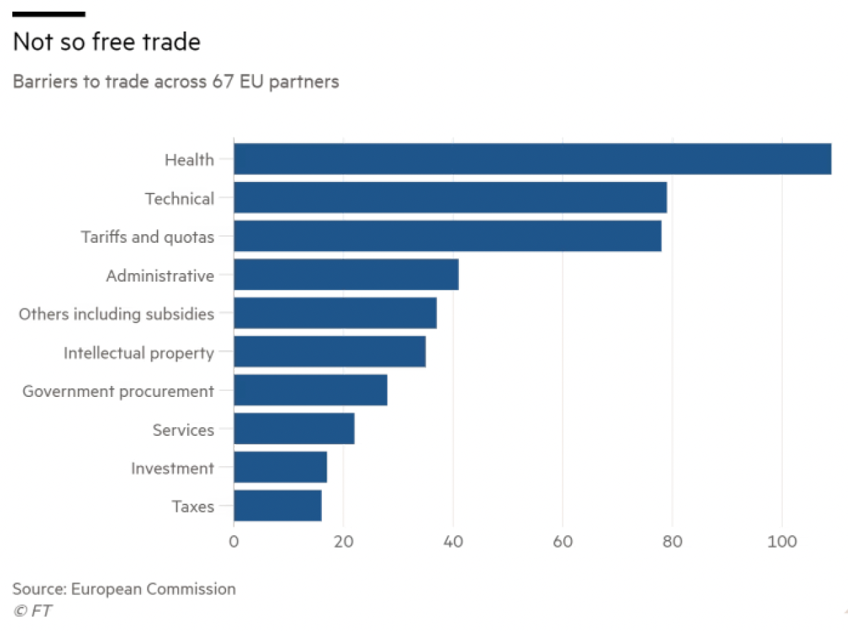
Notes:
Bounds, Andy, “EU steps up pressure to dismantle trade barriers,” Financial Times, October 27, 2021. [3p].
https://www.ft.com/content/b988cf7d-baf6-49ca-97c2-1ba16c6bdd10

Slide 61
EU and Other
After a 3-year delay, the EU completed a deal for an FTA with New Zealand
  Most difficult were negotiations on agricultural trade
  Regarding the agricultural package, the N.Z. trade minister said:
    “No one likes it, so we must have got it about right.”

Slide 62
Pause for Discussion

Slide 63
  Questions on Bounds,
  “EU steps up pressure…”
Are countries with which the EU has free trade agreements not lowering their tariffs?
What four countries are reported to have the most NTBs against EU exports? Do these have FTAs with the EU.
What are examples of the NTBs?
What actions has the EU taken, or planned, to deal with this?

Slide 64
  Questions on Bounds,
  “EU and New Zealand agree …”
Who announced the agreement and who “finalized” it?
When will this deal probably be signed and ratified?
What other trade deals has the EU done recently and where do they stand?

Slide 65
UK and Other
UK was unable to do FTAs while part of EU.
Since leaving EU, it has completed 37 FTAs, including one with EU. (Per WTO, Oct 21, 2022)

Slide 66
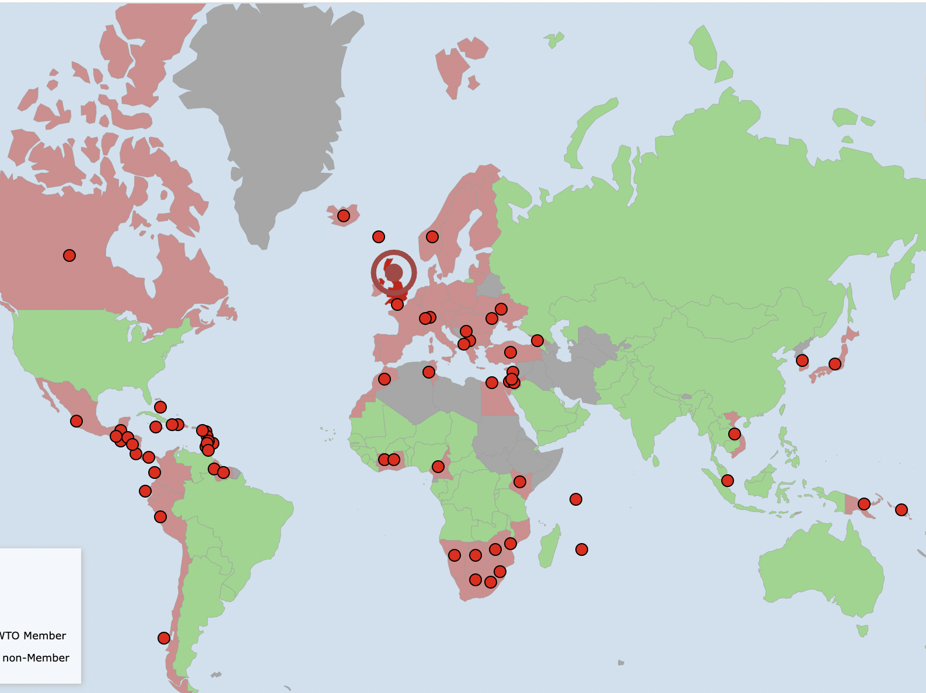

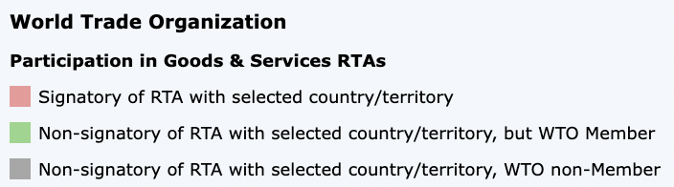
Notes:
http://rtais.wto.org/UI/PublicMaintainRTAHome.aspx

Slide 67
Pause for Discussion

Slide 68
  Questions on Economist,
  “Britain successfully rolled over”
How many trade deals had the UK completed by the date of this article (January 20, 2021)?
Why were these deals easier to reach than future ones will be?

Slide 69
  Questions on Pikard,
  “Boris Johnson overselling …”
Though the title here speaks of “post-Brexit trade deals,” what is the only such deal that is mentioned?
What are the complaints?
How do estimates of the effects on UK GDP of this deal and of Brexit compare?
What UK geographic indications are not protected in this deal, and why?

Slide 70
  Questions on Parkin and Reed,
  “India and UK to seal trade deal …”
How much remains to be done on the agreement?
Is this important to the UK?
What specific items of trade does this mention as opening up?
Does it extend beyond trade in goods?

Slide 71
Other Trade Deals
US is negotiating a deal with Taiwan, though it will not be an FTA.
Uruguay is seeking FTAs with countries outside Mercosur.
Israel completed a FTA with the United Arab Emirates

Slide 72
Pause for Discussion

Slide 73
  Questions on Swanson,
  “…Trade Dialogue With Taiwan”
Will this agreement, if reached, reduce US tariffs? Why or why not?
What issues will be discussed that are particularly relevant in contrast to China?
What sort of other issues will it address?
Is the negotiation being done by USTR?
What did Taiwan do in 2020 to facilitate these negotiations?

Slide 74
  Questions on Mander,
  “Uruguay roils Mercosur bloc …”
What countries are part of Mercosur, and what kind of trade agreement is it?
Why does Uruguay want to do separate trade deals with outside countries?
Is it possible for a member of Mercosur to agree on tariff cuts with outside countries?
Does Mercosur as a group have any trade agreements with outside countries?

Slide 75
  Questions on Kingsley,
  “Israel … Deal With U.A.E.”
Why is this agreement unprecedented?
What percent of tariffs between the countries will be removed, and when?
How long did it take to negotiate the deal?

